Slide 1

The Emerging Role of Applied Metabolomics
Incorporating Metabolomics In Practice
Presented by Betsy Redmond, PhD
Notes:
Metabolomics characterizes metabolites from cells, organs, tissues, or biofluids, and is improving our understanding of physiology and what’s normal, what’s normal for each person, and what identifies impairments.
Metabolomics is the scientific study of how metabolites can help evaluate unique fingerprints that identify specific cellular processes and provides a functional readout of the physiological state of an organism.
It can identify immune function, nutrient sensing and capacity, macronutrient catabolism and metabolism, gut metabolism, endogenous toxins, etc.

Slide 2
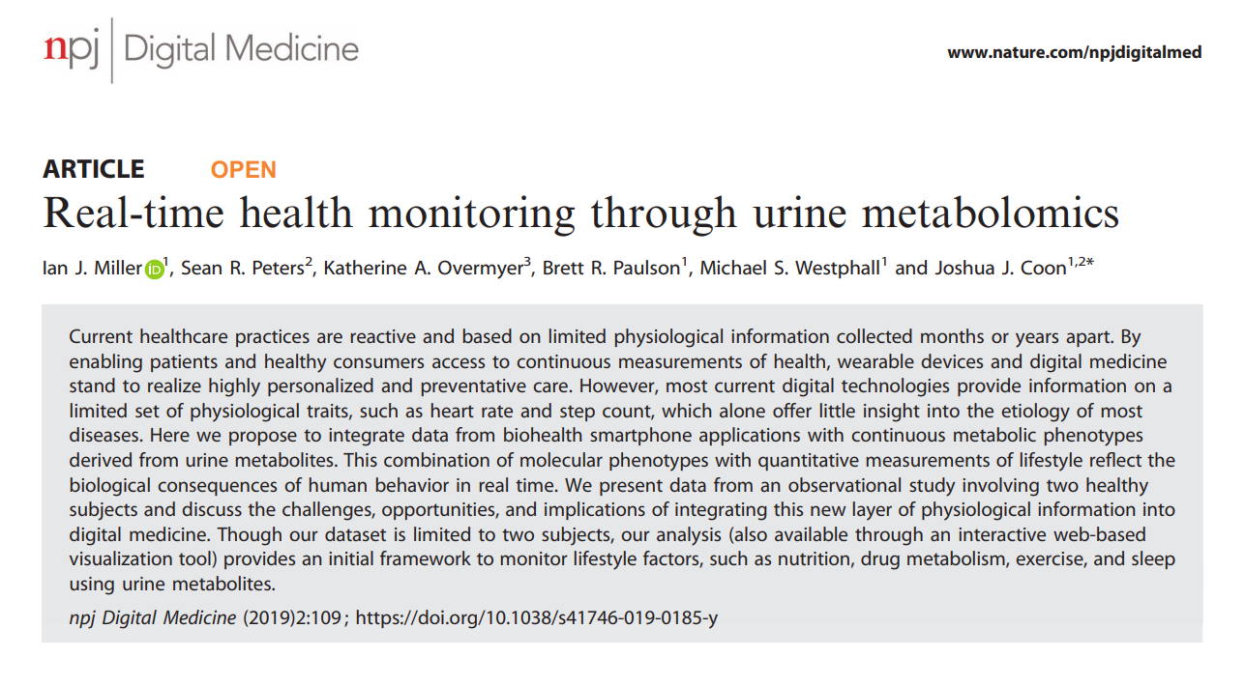
There are currently two avenues for continuous monitoring of health and disease: (1) consumer-grade wearables and (2) clinical based precision medicine
Miller IJ, Peters SR, Overmyer KA, Paulson BR, Westphall MS, Coon JJ. NPJ Digit Med. 2019;2:109.
Notes:
They state that Current healthcare practices are reactive and based on limited physiological information collected months or years apart. Over the course of 10 days, they collected every urine sample from two healthy individuals and tracked hundreds of urine metabolites - which is not practical or really necessary.
Metabolomics can help give direction and explanation to more conventional markers. Its not instead of its in addition to.
Researchers have long proposed, modern medicine will only be truly effective once it is has transitioned from reactive disease care to a framework that is “predictive, preventive, personalized, and participatory”

Slide 3
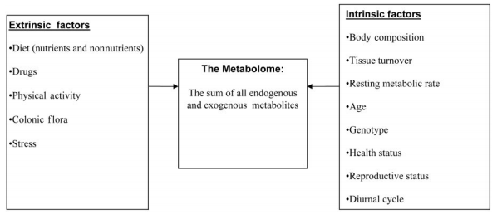
Metabolomic Testing
Extrinsic and Intrinsic Factors influence the metabolome
Am J Clin Nutr 2005;82:497–503. P
Notes:
BULLET #1
Patients have control over Extrinsic factors - Making it personalized and participatory
It can also be useful in helping clinicians target treatments by discriminating responders from non-responders or predicting effectiveness of a particular recommendation like exercise or supplementation. Making it predictive and preventive.

Slide 4
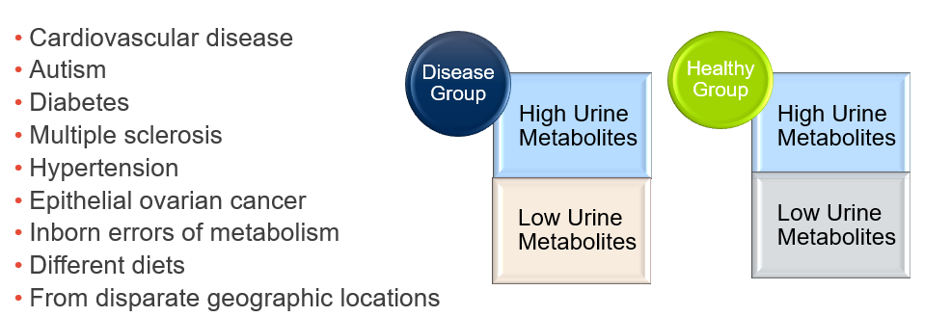
Early Metabolomics
Less sensitive detection capabilities
Evaluated the difference in sick versus controls
Notes:
More conventional researchers were sometimes unsure what those markers meant – Functional medicine had already been looking at these markers and had established plausible explanations

Slide 5
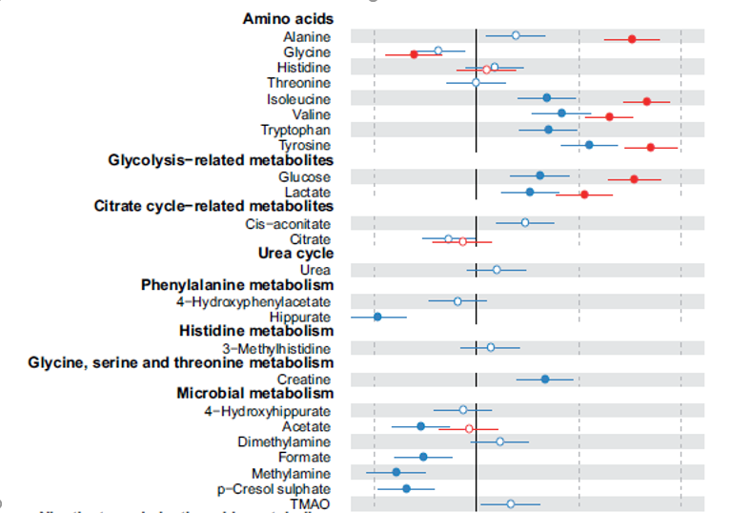
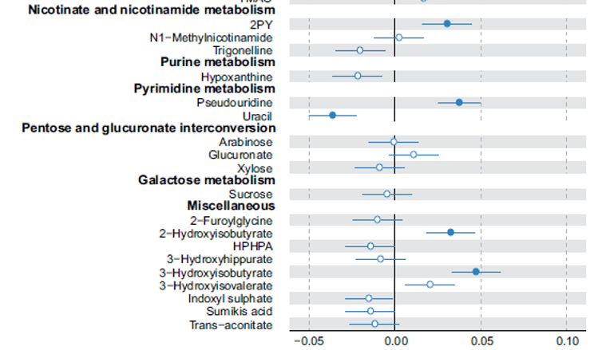



Notes:
This is a more detailed review of metabolomics on obesity.
Amino acids are significantly higher, except glycine, and microbial metabolism significantly lower.

Slide 6
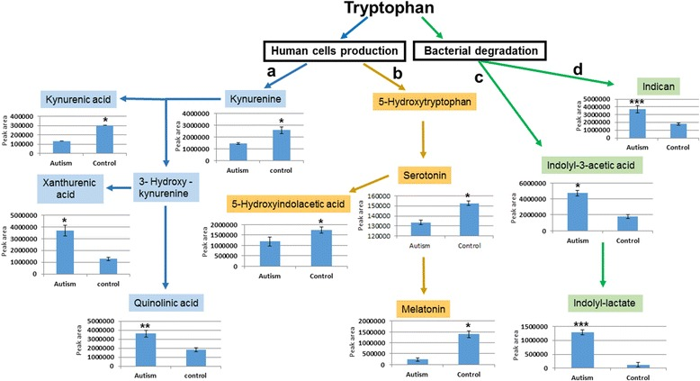
Understanding Pathways
Gevi et al. Molecular Autism (2016) 7:47
Notes:
It became obvious that you’d need to understand markers within pathways.
This study is common where they looked at the difference in each marker in the pathway, comparing case and control. This review of ASD and controls they found cases had more flow down the bacterial degradation pathway.
Its important to understand the pathways to understand metabolomics

Slide 7
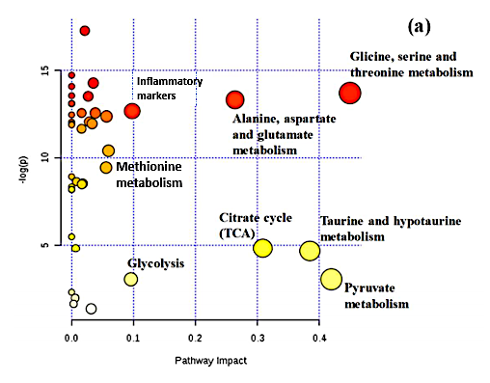
Identifying Patterns and Pathways
Tryptophan
Metabolism
Now evaluate specific pathway or function and what does it mean
Pattern-recognition techniques are now being used
Notes:
Research starting identifying patterns and pathways then starts connecting systems
It starts with an analyte, and looks at its overall catabolism, like tryptophan and all its downstream metabolites.

Slide 8
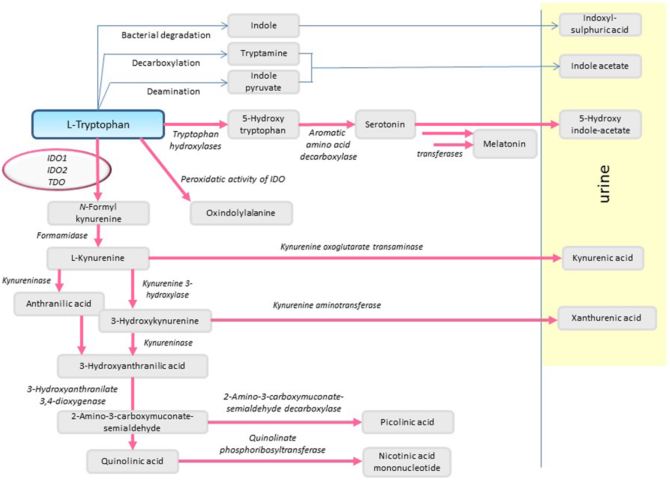
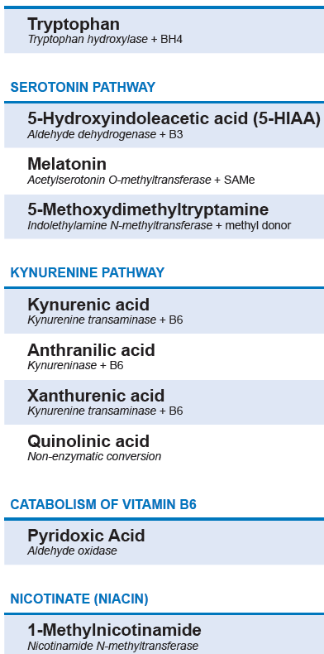
2% metabolized into serotonin
*B6
*B6
Primary pathway
*B6
*B6
Sedlmayr P. Front Immunol. 2014;5:230.
Notes:
6 min
Trp degradation not only leads to depletion of the amino acid but also to the production of metabolites displaying various biological activities.
Its important that when you’re looking at these pathways you have key markers, and look at them in the total of the pathway. Its not really accurate to simply look at one analyte and say you need a nutrient, you need to look at in the whole of the pathway to best evaluate it. Here is the tryptophan pathway. To start 2% -> serotonin, and most goes down the kynurenine pathway, which ends in NAD+ production.
Several of the enzymes require B6 but some are more sensitive than others

Slide 9

48-year-old Female:
Health Goal: Wants to decrease risk of developing prediabetes/diabetes
Currently:
Poor sleep habits, shift worker
Sedentary
BMI: 29
Family Hx: Diabetes
Diet: S.A.D./low carbohydrate diet
Low in low in vegetables, fruits, 2-3+ glasses of wine/day
Is interested in overall health…Metabolomics along with some conventional laboratory tests may help identify her unique chemical fingerprint to evaluate specific cellular processes.
Would she benefit from antioxidant support? Or glutathione support? Type of diet?
Notes:
Lets take a typical case
Which pathways are getting most stressed

Slide 10


“Our data suggest that robust metabolomics has the potential as a noninvasive strategy to evaluate the early diagnosis of T2D patients and provides new insight into pathophysiologic mechanisms and may enhance the understanding of its cause of disease.”
– Dr. Zhang
J Physiol Biochem, 70 (1), 117-28 (2013)
Notes:
J Physiol Biochem, 70 (1), 117-28
You don’t want to go right in with a blood glucose and diagnose her with diabetes or not. She may not actually be diabetic or even prediabetic but she may have a metabolomic fingerprint that identifies there could be an issue. That could help convince her to make changes earlier.

Slide 11
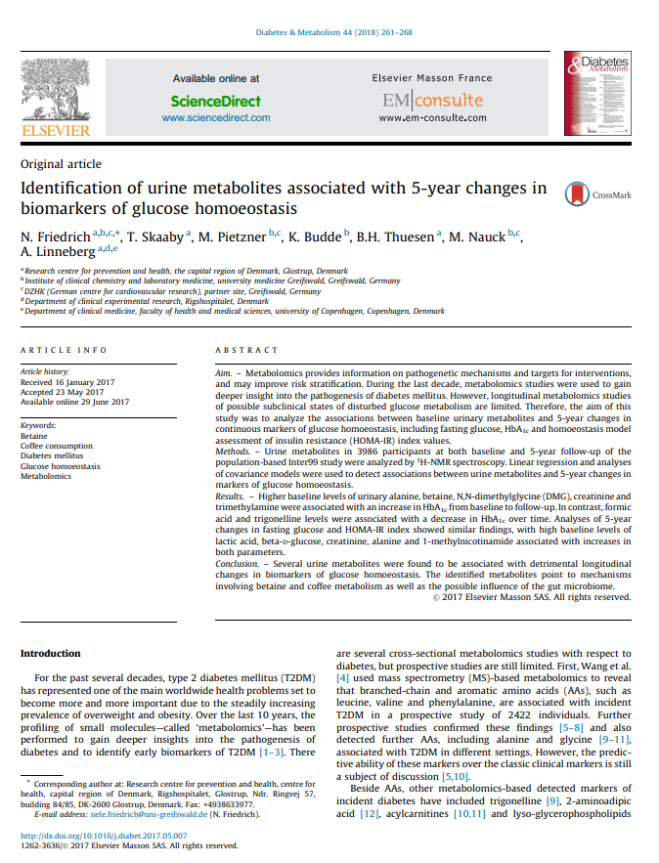
The aim of this study was to analyze the associations between baseline urinary metabolites and 5-year changes in continuous markers of glucose homoeostasis, including fasting glucose, HbA1c and homoeostasis model assessment of insulin resistance (HOMA-IR).
Urine metabolites (n=3986):
Baseline
5-year follow-up
Analyses of associations between urine metabolites and 5-year changes in markers of glucose homoeostasis
Whole Population and Subpopulation
BMI > < 25
Diabetes & metabolism. , 2018, Vol.44(3), p.261-268
Notes:
Inter99 Denmark
Subjects were drawn randomly from the Civil Registration System in Copenhagen. Baseline NMR measurements were available for 4117 subjects who participated in both the baseline and 5-year follow-up examinations.

Slide 12
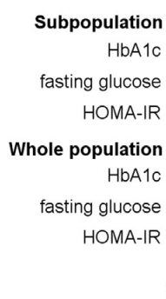
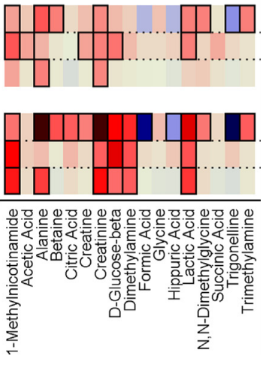
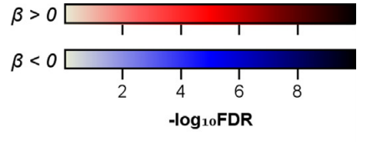
Baseline Metabolite with Longitudinal Changes Over 5-year Follow-up
Higher baseline levels of urinary 1-methylnicotinamide, alanine, betaine, creatinine, lactic acid, and trimethylamine (TMA) were associated with an increase in HbA1c from baseline to follow-up. Formic acid and hippuric acid were associated with a decrease in HbA1c.
Diabetes & metabolism. , 2018, Vol.44(3), p.261-268
Notes:
People with these markers are more likely to have a higher A1C in 5 years.
Subpopulation = apparently healthy subpopulation

Slide 13
Baseline Metabolite with Longitudinal Changes Over 5-year Follow-up.
Fasting glucose and HOMA-IR index showed similar findings, with high baseline levels of 1-methylnicotinamide, alanine, and lactic acid associated with increases in both parameters.
Diabetes & metabolism. , 2018, Vol.44(3), p.261-268
Notes:
Subpopulation = healthy population

Slide 14
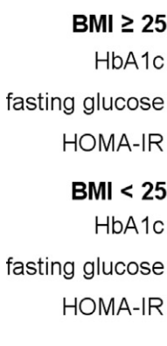
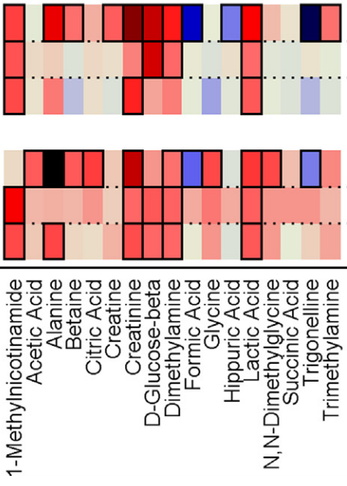
Association of baseline metabolite with longitudinal changes in continuous markers of glucose homoeostasis during the 5-year follow-up in lean (BMI < 25 kg/m2 ) and in overweight/obese (BMI > 25 kg/m2 ) subjects.
Tryptophan Metabolism
1-Methylnicotinamide
Betaine
Glycine Metabolism
Glycine
Hippuric acid
Krebs Cycle
Lactic Acid
Citric Acid
Formic Acid
Succinic Acid
Alanine
Trimethylamine (TMA)
Notes:
Associations in people who were heavier tended to be a little bit stronger.

Slide 15
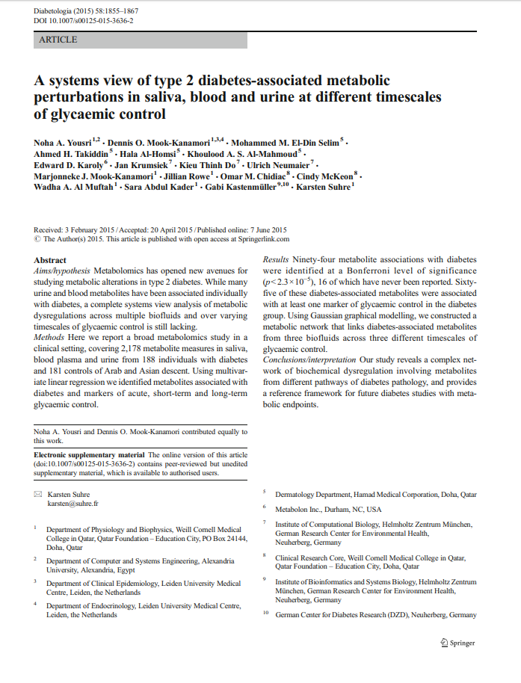
Urine Metabolites Associated with T2DM |  |  | Effect Size (sig p-value)
2-Hydroxybutyric acid (increased glutathione) |  |  | .88
Malic acid |  |  | .71
Leucine |  |  | .61
Isoleucine |  |  | .58
Phenylalanine |  |  | .57
4-Hydroxyphenylpyruvate |  |  | .58
Lactic acid |  |  | .58
Alanine |  |  | .54
Pyroglutamic acid (glutathione wasting) |  |  | -.75
Homovanilic acid |  |  | -.65
Homocysteine (impaired methylation) |  |  | -.63
1-Methylhistidine |  |  | -.59
Kynurenic acid |  |  | -.53
Positive β values indicate higher metabolite concentrations in diabetes patients compared to controls
Perturbations in the glycolysis pathway are reflected by increased pyruvate and lactate
Increased proteolysis with aminoaciduria is reflected by increased urinary BCAAs and aromatic amino acids (phenylalanine, tyrosine, tryptophan).
Notes:
This study from 2015 looked at metabolites associated with saliva, urine and blood. Urine has the earliest identification, blood is significantly later, why blood is used for diagnosis.
…again you see 1-methylnicatinamide is negatively associated with diabetes, and lactic acid and alanine are positively associated

Slide 16
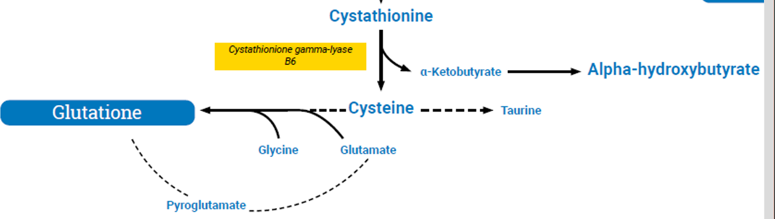
2-Hydroxybutyric acid
Glutathione synthesis may be reflected by urinary excretion of 2-hydroxybutyric acid, which has been identified as an early marker for both insulin resistance and impaired glucose regulation, and appears to arise due to increased lipid oxidation and oxidative stress.
Glutathione exerts feedback control on its own formation, to decrease the rate of synthesis of γ-glutamyl cysteine. Excessive production of pyroglutamate exceeds the capacity of 5-L-oxoprolinase. Glycine availability can lead to an increase in the excretion of pyroglutamate.
Br J Nutru. 1987 Sep;58(2):207-14.
Notes:
Oxidative stress or detoxification in the liver can dramatically increase the rate of glutathione synthesis causing supplies of cysteine for glutathione synthesis become limiting, so homocysteine is diverted for cystathionine donation. 2-Hydroxybutyric acid also known as alpha-hydroxybutyrate is released as a byproduct when cystathionine is cleaved into cysteine that is incorporated into glutathione.
Read BOLDED PRINT ON RIGHT SLIDE
Pyroglutamate identifies an inability to produce glutathione, and can identify a need for glycine support.
Read BOLDED PRINT ON LEFT SLIDE
These are pretty familiar…
Benzoic acid, by conjugation with glycine to form hippuric acid, is known to deplete the free glycine pool of the body. -Check Benzoate and Hippurate – if it is high it means you’re using up glycine.
https://pubmed.ncbi.nlm.nih.gov/3676243/?dopt=Abstract

Slide 17
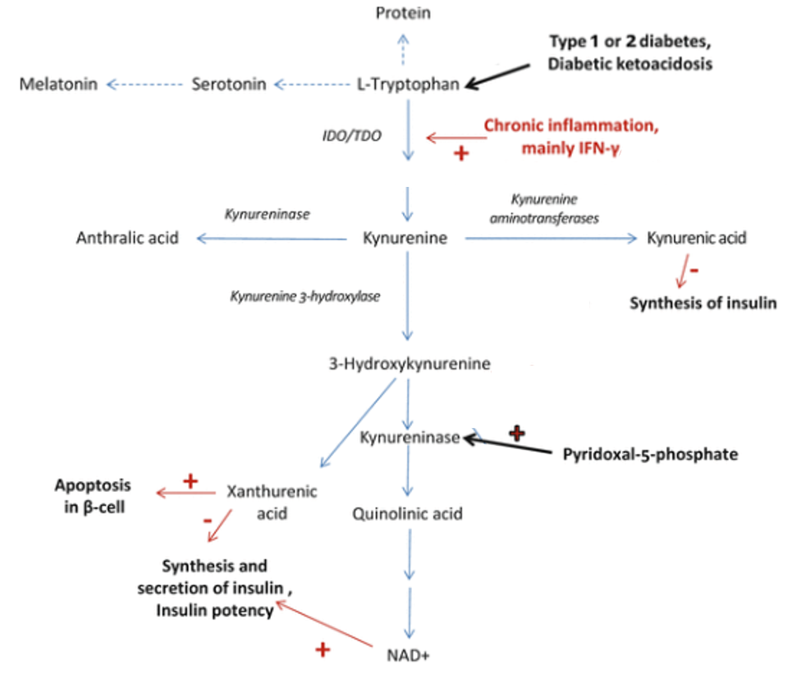
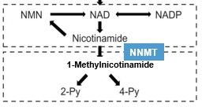
Urine 1-Methylnicotinamide (MNA)
Accumulating data indicate that an altered metabolism of tryptophan and its active metabolites have important roles for the pathogenesis and development of complications of diabetes mellitus.
Immune activation leads to formation of kynurenine and depletion of tryptophan.
Unluturk U., Erbas T. (2015) Diabetes and Tryptophan Metabolism. In: Engin A., Engin A. (eds) Tryptophan Metabolism: Implications for Biological Processes, Health and Disease. Molecular and Integrative Toxicology. Humana Press, Cham
Notes:
Another marker found to be an early predictor of impaired glucose or diabetes was 1-Methylnicotinamide - that can also be impacted with an impairment of glutathione production

Slide 18
Urine 1-Methylnicotinamide (MNA)
Higher urinary 1-Methylnicotinamide levels are found in patients with diabetes.
Nicotinamide N-methyltransferase (NNMT) was originally identified as an inactive metabolite of nicotinamide.
Recent evidence has expanded the role of NNMT beyond clearance of excess niacin (vitamin B3).
NNMT has been implicated in the regulation of multiple metabolic pathways.
Diabetes & Metabolism Vol 44, Issue 3, June 2018, Pages 261-268
Notes:
NNMT was thought for years to just be a clearance enzyme of excess niacin, but more recent evidence has identified it in the regulation of metabolic pathways.

Slide 19
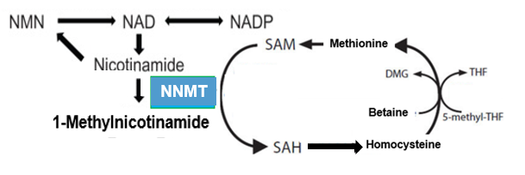
Urine 1-Methylnicotinamide (MNA)
1-methylnicotinamide is not just an inactive metabolite of nicotinamide.
Nicotinamide N-methyltransferase (NNMT) catalyzes the reaction between nicotinamide and S-adenosylmethionine (SAM) to produce 1-methylnicotinamide and S-adenosylhomocysteine (SAH).
High niacin (nicotinic acid and nicotinamide) intake is known to deplete the body's methyl-group pool.
NNMT + Nicotinamide + SAM = 1-methylnicotinamide + SAH
Scientific Reports vol 8, Article number: 8637 (2018)
Notes:
FIRST BULLET but then research took a closer look at the enzyme and found BULLET #2
nicotinamide is a precursors for NAD⁺ biosynthesis - NAD+ is used in metabolic pathways as a cofactor.
BULLET #2
In animal studies NNMT overactivation decreased the NAD⁺ content in the liver and also decreased gene activity by inhibiting NAD⁺–dependent enzymes (deacetylase Sirt3 function). Scientific Reports volume 8, Article number: 8637 (2018)
BULLET #3

Slide 20
Urine 1-Methylnicotinamide (MNA)
Elevated 1-Methylnicotinamide
Baseline levels of 1-Methylnicotinamide were associated with higher A1c, fasting glucose and HOMA-IR index.
1-Methylnicotinamide was increased in patients with cirrhosis and cancers, suggestive of increased NNMT activity.
Reduced 1-Methylnicotinamide
A persistent lower level of 1-Methylnicotinamide may participate in allergic reactions in response to allergen exposure.
In a study of pellagra patients and controls, whole blood NAD and NADP gave an erroneously low estimate of niacin deficiency. In contrast, spot urine of 1-Methylnicotinamide concentrations was a sensitive and specific measure of deficiency.
J Nutr 137 (9), 2013-7 Sep 2007
Scientific Reports volume 8, Article number: 8637 (2018)
Notes:
1-Methylnicotinamide has a normal range, and too high or too can indicate an issue
Protective effect of low MNA levels; As fat cells grow they overexpress NNMT which slows down metabolism and energy consumption, and encourages the development of fat tissue.

Slide 21
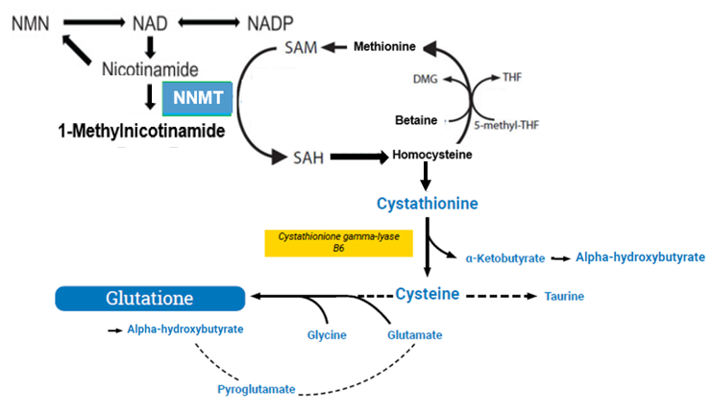
Methionine Cycle and SAM Generation
The methionine cycle is a collection of enzymatic activities that catabolize and recycle methionine and its products.
The principal function of the methionine cycle is to dispose of excess Methionine and to generate SAM, the universal methyl donor.
The methionine cycle and glutathione production both become impaired in early metabolic issues.
Trends Endocinol Metab, 28 (5), 340-353
Notes:
1-methylnicotinamide is linked to the methionine cycle and glutathione.
Bullet #2
BULLET #3 – this identifies how they are related.
Betaine and glycine are both also key urine markers in this pathway, and two that I would want to look at in someone concerned with a metabolic condition like prediabetes/diabetes., someone with an elevated 1-methylhistidine.
Dietary methionine restriction (MR) extends life span across species via various intracellular regulatory mechanisms.
Short term exercise has been shown to decrease plasma concentrations of methionine, and longer term can decrease glutathione synthesis.

Slide 22
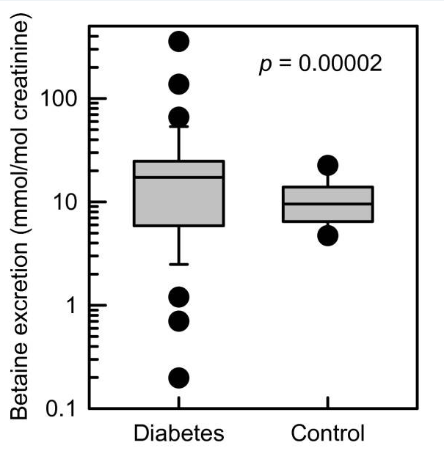
Urine Betaine
Betaine serves as a methyl donor helping to convert homocysteine to methionine and excretion correlates with plasma homocysteine.
Betaine preserves tissue integrity and protects kidney cells.
Urine Betaine has been found higher in those with diabetes, obesity and metabolic syndrome.
Lever, M. Cardiovasc Diabetol: 2012; 11: 34.
Schartum-Hansen H, Ueland PM, PLoS One. 2013;8(8):e69454.
Notes:
JUST READ HERE: So betaine first - Betaine plays a key role within the methionine cycle. Betaine has been found to be higher overall in those with diabetes, obesity and metabolic syndrome, though some research has found it both higher and lower – its generally outside of the reference range.
In this study they evaluated the discriminatory ability of urine betaine to identify patients with diabetes mellitus. The AUC for betaine excretion at baseline was 0.82 (0.7920.86), so it has a good discriminatory ability.
https://www.ncbi.nlm.nih.gov/pmc/articles/PMC3735559/

Slide 23
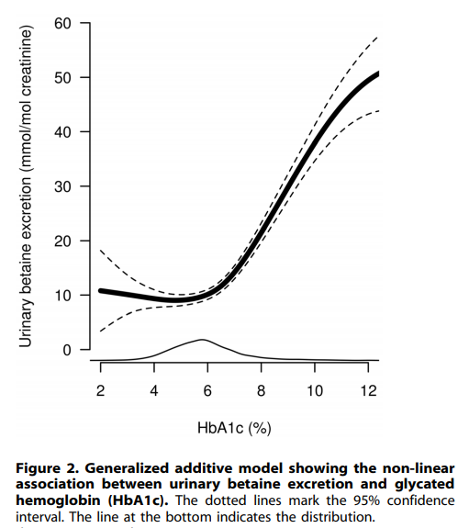
Urine Betaine
Researchers have noted an association between urine betaine excretion and glycated hemoglobin.
Sources of betaine: wheat bran, wheat germ, spinach, and beets.
Lever, M. Cardiovasc Diabetol: 2012; 11: 34..
Notes:
BULLET #1
Urinary betaine showed no relationship with A1C below levels of about 6% and a strong positive relation at higher levels. Using segmented regression, researchers identified a break-point (95% CI) of ~6.5 (6.3–6.7)%, p<0.001.
In people without diabetes plasma and urine betaine rise slowly together, but in those with diabetes urine decreases significantly as plasma levels rise. https://www.ncbi.nlm.nih.gov/pmc/articles/PMC3735559/
As betaine increases in the urine it decreases in the blood –

Slide 24
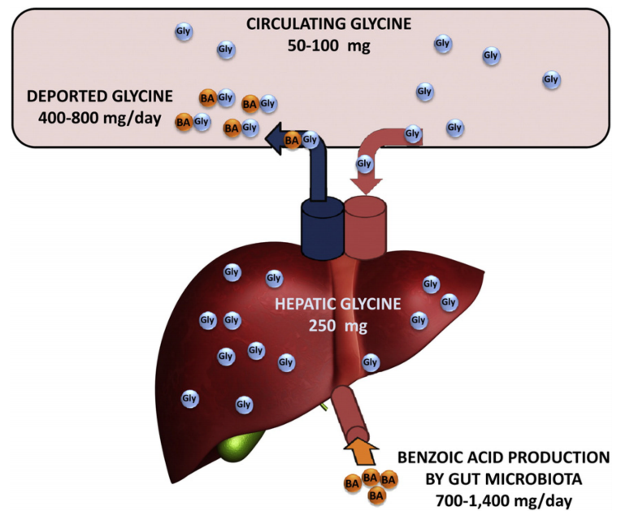
Urine Glycine
Glycine is one of three amino acids used to form glutathione and supplementation has shown to support glutathione status.
Glycine is found in circulation, in the liver, or its gets deported after binding with benzoic acid.
Benzoic acid is produced by gut bacteria, and can also comes from the diet.
Pharmacol Ther. 2012 August ; 135(2): 151–167.
Nutrients. 2019 May; 11(5): 1056.
Notes:
I’d also look at glycine -
Bc glycine is so important to glutathione production, its supplementation should be considered in supporting glutathione. In the case where glycine availability is reduced, for example by malnutrition or diabetes, reduced glycine availability may become a limiting factor for GSH synthesis.
BULLET #2
Gut microbiota produce benzoic acid which is absorbed into the liver by the hepatic portal vein
Benzoic acid also comes from the diet
its added as a preservative, in wines, fruit juices, yogurts, butter, syrups, and various cheeses, so someone on a SAD diet could inadvertently get an excess intake of BA.
Benzoic acid binds with glycine to produce hippurate

Slide 25
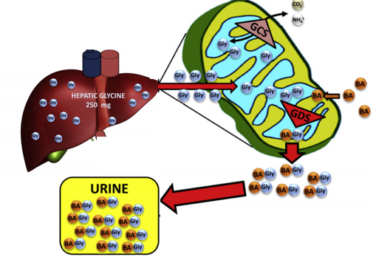
Urine Glycine
The glycine deportation system (GDS) in the mitochondrial matrix uses predominantly benzoic acid to escort glycine via the formation of hippuric acid.
Pharmacol Ther. 2012 August ; 135(2): 151–167.
Notes:
The glycine deportation system is an essential component of glycine catabolism it uses predominantly benzoic acid as an escort molecule for glycine – as a couple they’re referred to as Hippurate. So if Hippurate is significantly elevated it can mean that a lot of glycine is being excreted, and a lot of benzoate is being produced by gut microbiota or being eaten.
The glycine cleavage system (GCS) that can resynthesize GLY – and is NADH-dependent

Slide 26
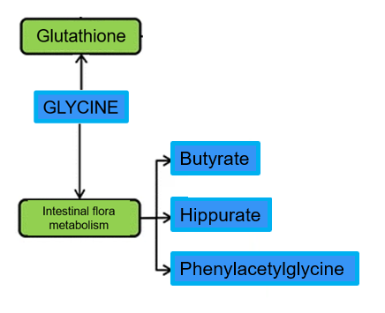
Urine Phenylacetylglycine
Glycine can also conjugate with phenylacetate, a metabolite of phenylalanine, and produce phenylacetylglycine.
Phenylacetylglycine is generated from phenylacetate via phase II detoxification or from microbiota metabolism, and is often overexpressed in disease.
phenylacetate
Notes:
Glycine is also involved in a lot of conjugation – it can conjugate with phenylacetate, a metabolite of phenylalanine, and produce Phenylacetylglycine
Phenylacetylglycine is a glycine conjugate, and is often overexpressed in disease.
Phenethylamine from food is quickly metabolized to into phenylacetate by monoamine oxidase to prevent significant concentrations from reaching the brain. Individuals with an impaired ability to convert to phenylacetate may have symptoms of headache, dizziness, and other discomfort when supplementing with phenylalanine.
-------------------------
Changes of benzoate, hippurate, glycine and PAG levels in the urine may indicate abnormal intestinal microbial metabolism.
https://arthritis-research.biomedcentral.com/articles/10.1186/s13075-016-1139-2#article-info

Slide 27
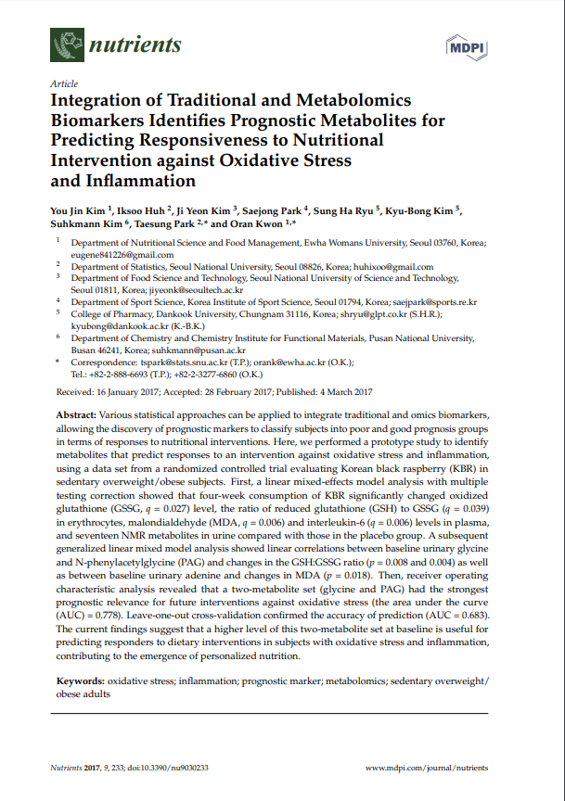
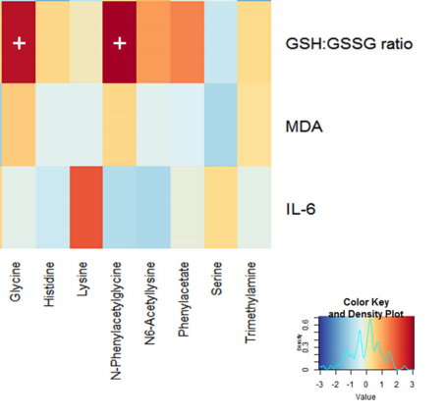
Urine Phenylacetylglycine
Glutathione is an antioxidant systems that protect against oxidative stress.
Urinary glycine and phenylacetylglycine were positively associated with an increase in the erythrocyte GSH:GSSG ratio (reduced to oxidized glutathione).
Nutrients. Nutrients. 2017 Mar; 9(3): 233.
Clin Chem Acta 2012 Oct 9; 413(19-20);1446-1453.
Ther Ad Drug Saf 2013 Jun; 4(3): 101–114.
Antioxid Redox Signal. 2016;26(3):119-146
Notes:
They looked at the associations between the changes in traditional biochemical markers and urinary metabolomic signatures at baseline- Asking what baseline biochemical characteristics would identify those people who would most likely respond positively to the antioxidant supplementation.
BULLET #2
Their findings suggest that a higher level of this two-metabolite set at baseline is useful for predicting responders to dietary interventions in subjects with oxidative stress and inflammation, contributing to the emergence of personalized nutrition.
The researchers looked at supplementing with Korean black raspberry. Receiver operating characteristic analysis revealed that a two-metabolite set (glycine and PAG) had the strongest prognostic relevance for future interventions against oxidative stress (the area under the curve (AUC) = 0.778).
--------------------
The ratio of reduced to oxidized glutathione is often used as a marker of cellular toxicity. In a resting cell, you normally have way more reduced glutathione, and the GSH:GSSG ratio exceeds 100:1, but with increased oxidative stress, this ratio can decrease to10:1 and even 1:1 - https://www.ncbi.nlm.nih.gov/pmc/articles/PMC3506742/
Reduced glutathione (GSH) is considered to be one of the most important scavengers of reactive oxygen species, and its ratio with oxidized glutathione (GSSG) may be used as a marker of oxidative stress.
The authors suggested that the subjects who have a statistically higher mean value of urinary glycine and PAG may have a good prognosis following a nutritional intervention against oxidative stress. High urinary glycine is associated with accelerating GSH restoration against the oxidative stress. PAG is a glycine conjugate, which is expected to respond in the same direction with glycine.
KBR decreased inflammation- noted by an increase of reduced to oxidized glutathione ratio, and a paralell increase in glycine and Phenylacetylglycine
https://www.ncbi.nlm.nih.gov/pmc/articles/PMC4110864/Ther Adv Drug Saf. 2013 Jun; 4(3): 101–114.
“it looks like you could be a good candidate for antioxidant treatment. Lets start with that.”

Slide 28
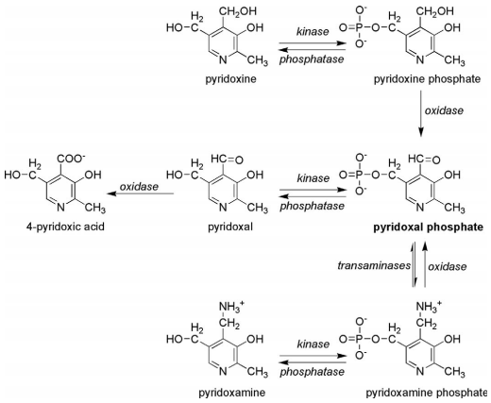
Urine Pyridoxic Acid (PA)
Pyridoxic acid is the catabolic product of vitamin B6 and represents > 90% of vitamin B6 species, and about half of the dietary vitamin B6.
Urinary Pyridoxic acid varies according to vitamin B6 intake and responds within 1–2 weeks to vitamin B6 depletion and repletion.
Pyridoxic acid spot urine and 24-h samples are both acceptable measures, and no difference was found with either morning or afternoon random samples.
Journal of Evidence-Based Complementary & Alternative Medicine 16(1) 2011
Notes:
Going back to out 48 year old female, bc several of the key arms of the tryptophan pathway depend on B6 its also important to check B6 levels.

Slide 29
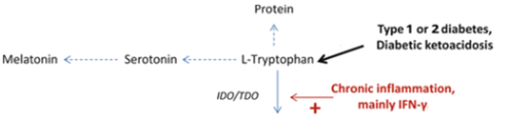
Urine Melatonin
Melatonin regulates sleep and wakefulness, circadian rhythms
Lower melatonin secretion has been independently associated with a higher risk of developing type 2 diabetes.
Melatonin is a potent ROS scavenger and can modify 8‑OHdG levels.
Supplementation melatonin rich foods before sleep increased melatonin and improved sleep quality.
Unluturk U., Erbas T. (2015) Diabetes and TryImplications for Biological Processes, Health and Disease. Molecular and Integrative Toxicology. Humana Pressptophan Metabolism. In: Engin A., Engin A. (eds) Tryptophan Metabolism:, Cham
Notes:
Additionally melatonin is a component in the tryptophan pathway that can also give insight into risk of diabetes.
BULLET#2

Slide 30
8-hydroxy-2′-deoxyguanosine
8-hydroxy-2′-deoxyguanosine is a biomarker of oxidative status and a stable end product of non-enzymatic DNA oxidation.
8-OHdG evaluates oxidative DNA damage in patients with diabetes, and may be helpful for the early diagnosis and treatment of patients with diabetic retinopathy.
Dong QY. Eur J Ophthalmol. 2008;18(1):94–98.
Clin Chem Acta. 2012 Oct 9; 413(19-20): 1446-1453

Slide 31
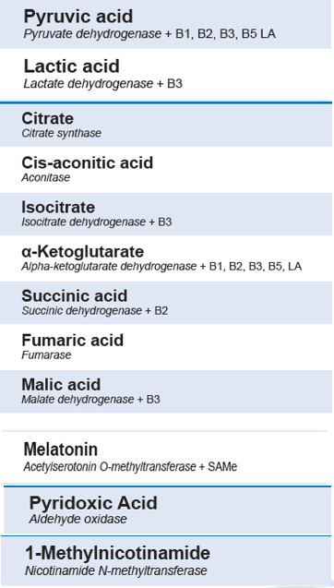
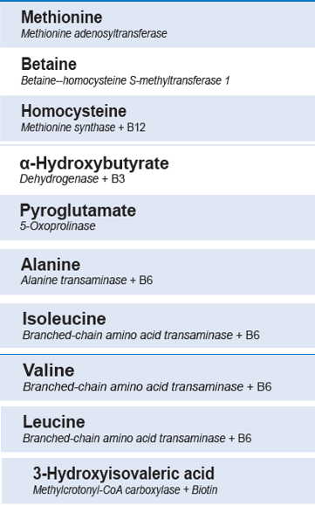
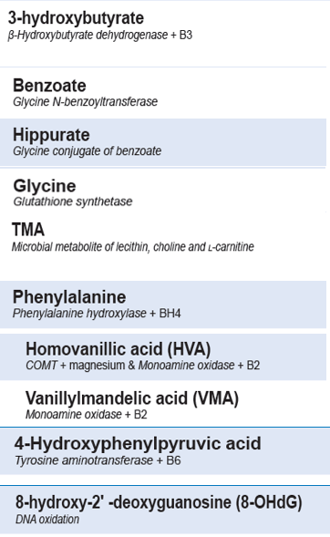

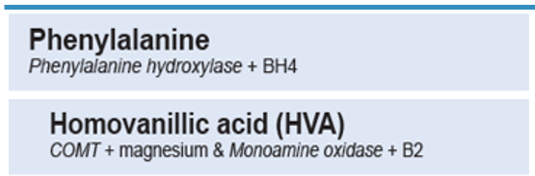
Phenylacetylglycine

Slide 32
48-year-old Female:
Health Goal: Wants to decrease risk of developing prediabetes/diabetes
Plan:
Work on sleep hygiene
Increase activity
Diet: Change to a more Mediterranean diet
High in vegetables, fruits, less wine
Introduce time restricted feeding
Supplement Support:
CoQ10 (200mg/d capsules)
Complete Multi
B supreme
Glycine support
Notes:
Which pathways are getting most stressed

Slide 33

Goal: Weight Loss and Better Health
Gastrointestinal issues for ~6 years,? irritable bowel syndrome, constipation, perimenopausal
Family history of cardiovascular disease, considering taking statins
LDL: 141
ApoB: “elevated”
BMI: 31
Diet: Standard American Diet, trying to eat more meat (protein), less carbohydrate (fiber)
Activity: has a pedometer gets ~3k steps/day
Starting with urine metabolomics
Notes:
Products of bacteria are influenced by diet, lifestyle factors, medications, etc.
I felt like a patient like this could have an imbalance of saccharolytic and proteolytic gut metabolism.

Slide 34
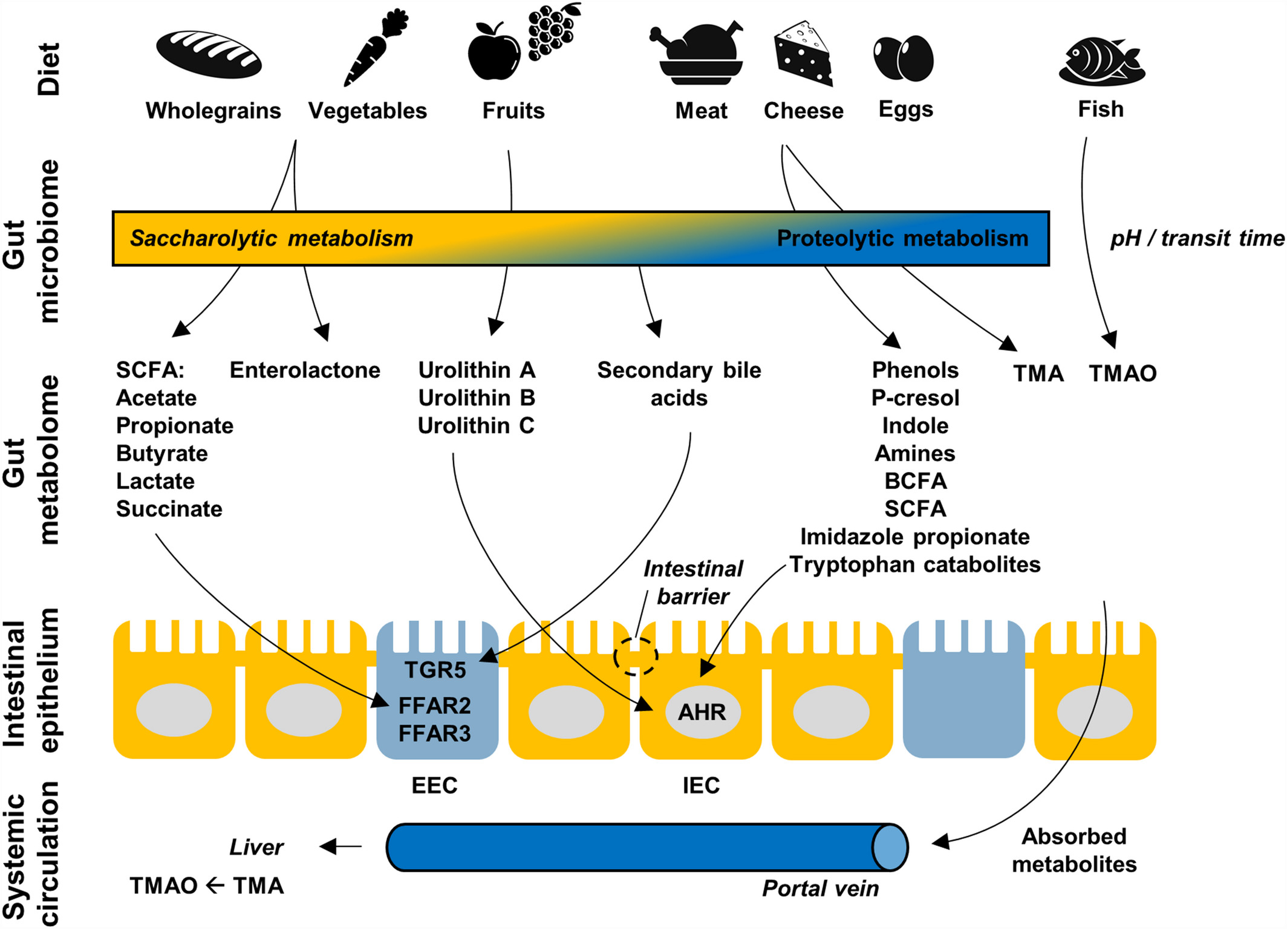
Lignan
Metabolites
Ellagitannins
Metabolites
Choline/Carnitine Metabolites
Phytoestrogen
Metabolites
(valerate, iso-valerate and iso-butyrate)
Phenolic
Metabolite
& Phenylalanine/Tyrosine Catabolites
(Indoleacetic acid)
(p-cresols, 3-Hydroxyphenylacetic acid,
p-Hydroxyphenylacetic acid
British Nutrition Foundation Nutrition
Bulletin, (2019) 44, 216–227
Notes:
Carbohydrate fermentation occurs primarily in the proximal colon, resulting in a distal colon containing low fermentable substrate. Protein flowing into the large intestine may come from undigested food, bacterial cells, and endogenous gut losses, which can include protein from enzymes, mucus, and sloughed epithelial cells. Increasing your protein intake will increase your proteolytic gut compounds.
The small intestine makes the largest contribution to endogenous losses and can be affected by factors such as protein quality and fiber intake. This effect may depend on the degree to which a given fiber can increases enzyme secretion and mucous production or decreases the digestibility of amino acids in the small intestine. For example, wheat bran, increases endogenous loss, while no effect is seen with cellulose.
Its important to look at these levels
AHR: aryl hydrocarbon receptor

Slide 35
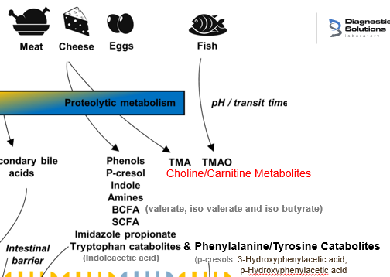

Proteolytic Microbial Metabolites
Proteolytic metabolites impact both the gut and systemic circulation, leading to bioactive molecules that can increase negative reactions, inflammatory. responses, tissue permeability, etc.
Proteolytic metabolites have been implicated in metabolic disease, including obesity, diabetes, colitis and non-alcoholic fatty liver disease.
The amino acids with significant information in urine are:
Phenylalanine
Tyrosine
Tryptophan
Notes:
She had a very high protein diet and a low fiber intatke.
Fermentation of aromatic amino acids, phenylalanine, tyrosine, tryptophan, may be particularly important biologically. as they generates a wide range of bioactive end products such as phenol and p-cresol (Tyrosine), or indole and skatole (Tryptophan).
Proteolytic fermentation products such as p-Cresol may also contribute to the development of colorectal cancer. These findings are in conflict with other studies showing that tryptophan metabolites may improve gut barrier function.
If you’re eating a lot of protein, also get a lot of fiber.

Slide 36
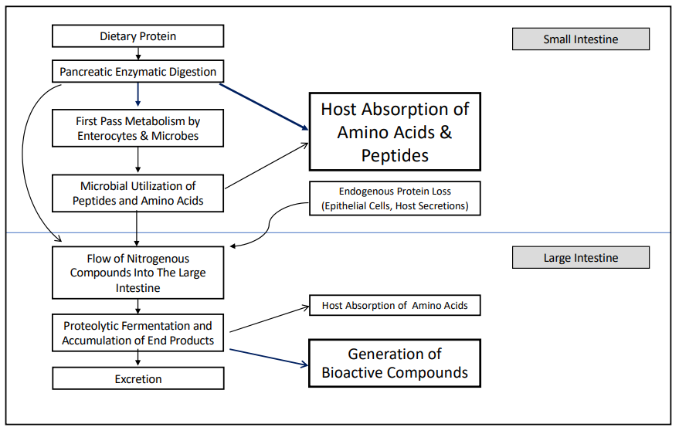
Proteolytic Microbial Metabolites
Diether, N., Willing, B. Microorganisms 2019, 7, 19
Notes:
Despite the fast transit time and a high degree of host absorption of peptides and amino acids, evidence suggests that microbial utilization of amino acids begins in the small intestine.
Increased protein intake results in increased generation and excretion of amino acid metabolites.
Carbohydrate intake alters amino acid utilization by microbes, reducing the uptake of some amino acids, such as tyrosine, and increasing the use of others, including valine. Carbohydrate fermentation can also strongly inhibit the formation of specific products such as p-cresol.
If you’re eating a lot of protein you’re going to have higher proteolytic markers, certinianly also getting a lot of fiber helps dilute the protein fermentation products.

Slide 37
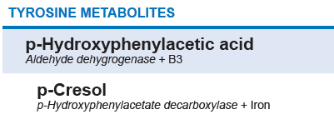
Tyrosine Microbial Metabolites
p-Cresol (4-Hydroxybenzeneacetate)
Phenylalanine ➞ Tyrosine (microbiota) ➞ p-Hydroxyphenylacetic acid ➞(putrefaction) ➞ p-cresol
Urinary p-cresol is implicated in kidney disease, found higher in ASD, ASD severity, GI conditions such as colon cancer.
In a large review of metabolites in the general population p-cresol clustered with TMAO.
People with high levels of p-cresol-producing bacteria and eating a diet low in sulfur-containing foods (garlic, onions, cabbage) may be more prone to acetaminophen toxicity.
Higher levels associated with chronic constipation.
Urinary p-cresol excretion was significantly decreased after wheat bran extract intake at 10 g/d.
Fecal Bifidobacteria levels were significantly increased.
Br J Nutr. 2012;108(12):2229–2242.
Autism Res. 2016;9(7):752–759.
BMC Nephrol. 2014;15:87..
Notes:
After #2 bullet:
A uremic toxin that represents the end-catabolism of tyrosine and phenylalanine, indicates an alteration of gut microbial metabolism. p-cresol may also cause DNA damage and alter the cell cycle, decreasing colonocyte proliferation
In patients (n=200) with chronic kidney disease, intestinal uptake of p-cresol was associated with cardiovascular disease independent of renal function.

Slide 38
Tryptophan Microbial Metabolites
3-Indoleacetic acid or Indoleacetic acid (IAA)
Tryptophan (microbiota) ➞ Indole acetamide ➞ 3-Indoleacetic acid
Tryptophan is involved in the balance between intestinal immune tolerance and gut microbiota maintenance via tryptophan metabolites.
AhR is activated (or deactivated) by a number of indole derivatives.
Bacterial tryptophan metabolites impact gut microbial composition, microbial metabolism, the host's immune system, the host-microbiome interface, and host immune system-intestinal microbiota interactions.
Patients with epithelial cancers, ASD, liver disease, had elevated levels.
Front Cell Inect Microbial 2018 Feb 6;8:13.
Notes:
aryl hydrocarbon receptor (AhR) is an important transcription factor which may implicate in endocrine regulation, cytokine signaling, and may decrease cancer development.
Trptophan can be catabolized to indoleacetic acid by bacteria including Bifidobacterium, Bacteroides, Bacillus or Pseudomonas aeruginosa, and has been noted as a marker of microbial activity

Slide 39
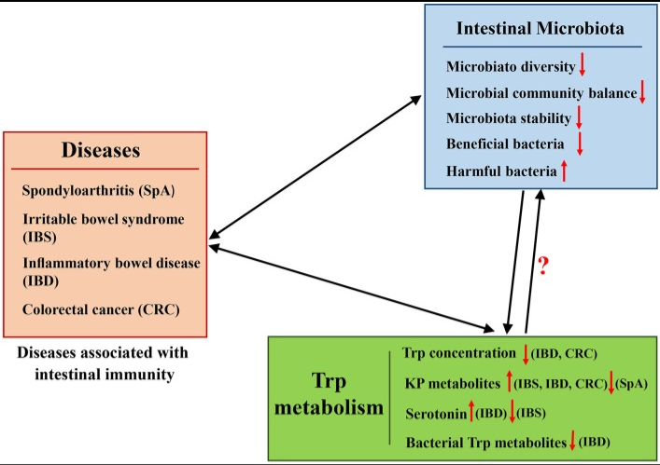
Tryptophan Microbial Metabolites
Front Cell Inect Microbial 2018 Feb 6;8:13.
Notes:
What conditions you’re looking at and what markers are elevated or decreased.

Slide 40
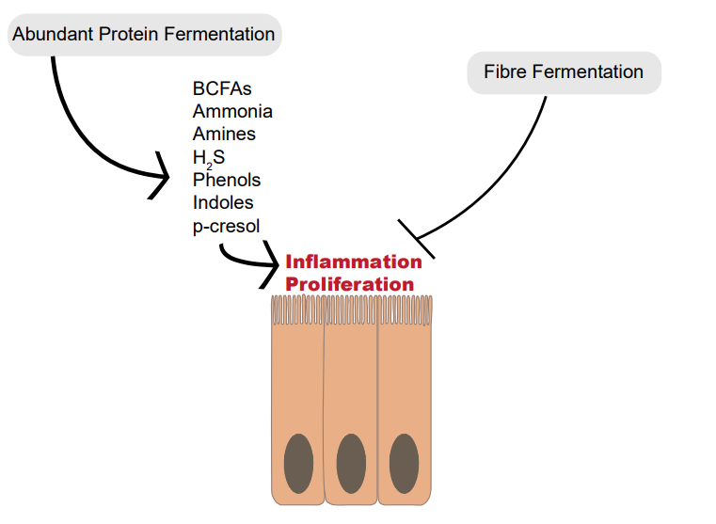
Diether, N., Willing, B. Microorganisms 2019, 7, 19
Notes:
Abundant proteolytic fermentation generates a multitude of compounds that may cause the inflammation and proliferation of colonocytes, and in turn, colorectal cancer. Increased fiber fermentation and short-chain fatty acid production appears to be protective against colorectal polyp development, even when protein fermentation products are abundant.

Slide 41




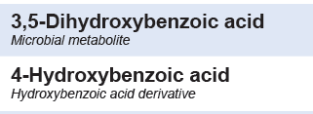

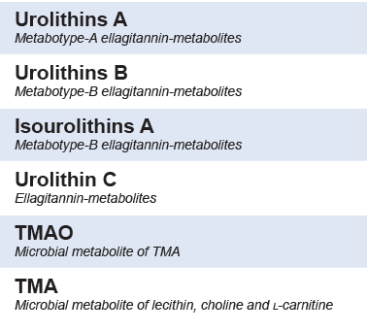
DIETARY MICROBIAL METABOLITES
Phytoestrogen Metabolites
Lignan-Derived Metabolites
Phenolic Metabolite
Ellagitannins Metabolites
Choline and Carnitine Metabolites
Notes:
How is her diet impacting her microbial activity?
Microbial-derived metabolites have been associated with increased and decreased risk of disease.
Metabolites can be from bacteria alone or are the product of bacterial action on specific dietary component, or due to other lifestyle factors, medications, etc.
The microflora can change constituents in food and make them available to themselves or the host for additional metabolism.

Slide 42
DIETARY MICROBIAL METABOLITES Phytoestrogen Metabolite:
Equol is a bacterial metabolite of isoflavones (soy), it gets hydrolyzed to daidzein.
Equol is the isoflavone-derived metabolite with the significant estrogenic and antioxidant activity.
The ability to produce equol varies among the individuals, because only people who possess the ‘right’ intestinal bacteria are capable of producing equol, and are regarded as equol producers.
It may be that only specific subjects can fully benefit from soy intake.
Notes:
Soy (soybeans, tofu, tempeh, miso, natto) is a good source of isoflavones, (genistein, daidzein), which are known to protect against, osteoporosis, heart disease, high blood cholesterol, dementia, cancer, etc. BUT you don’t get the full effect from just eating soy – the effect is actually from the breakdown of isoflavones, and the composition of your gut bacteria (microbiota) influence how much gets broken down to the active compounds.
If you are going to recommended isoflavones it is good to get a baseline level and a follow up to see the client is responding

Slide 43

DIETARY MICROBIAL METABOLITES Phytoestrogen Metabolite:
Hops contains the potent phytoestrogen 8-prenylnarigenin (8-PN) and has been shown to act as an aromatase inhibitor that could protect women from estrogen carcinogenesis.
Strong 8-PN producers drank less alcohol and had higher theobromine intake.
8-prenylnaringenin belongs to the group of prenylated flavonoids and was shown to be a potent phytoestrogen.
Clinical trials reported that 8-PN in the form of a standardized hop extract has the ability to alleviate menopausal symptoms.
A positive trend between methane excretion (via breath tests) and urine 8-PN production (50 healthy post-menopausal women).
Molecules 2018 Mar; 23(3): 660.
Chem Res Toxicol. 2019 Feb 18; 32(2): 222–233.
Bolca, S. Br J Nutr. 2007;98(5):950-9.
Notes:
Its not just equol, Estrogenic effects associated with hops which has a potent phytoestrogen 8-PN
It binds tighter to ERα compared to Erβ
Hop (Humulus lupulus L.), as a key ingredient for beer brewing, is also a source of many biologically active molecules. A notable compound, 8-prenylnaringenin is structurally belonging to the group of prenylated flavonoids, was shown to be a potent phytoestrogen, and thus, became the topic of active research.

Slide 44
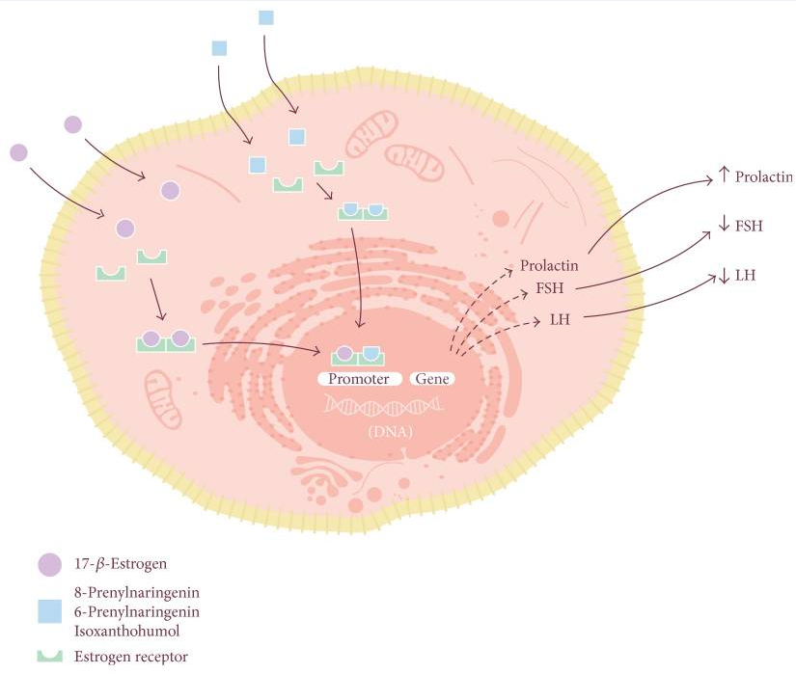
Beer Polyphenols and Menopause: Effects and Mechanisms-
A Review of Current Knowledge. Oxid Med Cell Longev. 2017;2017:4749131.
Notes:
Mechanism of phytoestrogens. Like estrogen, phytoestrogen molecules travel through plasma and diffuse into the target cells, where they bind to cytoplasmatic estrogen receptors (ER). The new molecule-ER complex then dimerizes and is translocated into the nucleus, where it binds to specific promoters that decrease the expression of genes translating hormones such as follicle-stimulating hormone (FSH) and luteinizing hormone (LH) and promote the translation of prolactin. The use of estrogen receptors by 17-b-estrogen and molecules such as 8-prenylaringenin, 6-prenylaringenin, and isoxanthohumol explains why these molecules can be used to decrease the intensity of many classical symptoms of menopause.
https://www.ncbi.nlm.nih.gov/pmc/articles/PMC5585550/

Slide 45
DIETARY MICROBIAL METABOLITES Lignan-Derived Metabolites
Enterodiol and Enterolactone, enterolignans, are metabolic derivatives of lignans (seeds, cereals, fruit, berries and vegetables).
Conversion is dependent on gut microbiota
Represents dietary fiber intake
Because the conversion involves several steps and transformations they are considered biomarkers of microbiota diversity, with higher levels indicating greater diversity.

Slide 46
DIETARY MICROBIAL METABOLITES Phenolic Metabolite
Produced in the lower gastrointestinal tract by microbial catabolism
3,4-Dihydroxyhydrocinnamic acid is a metabolite of flavonoids and in food; orange juice.
3,5-dihydroxybenzoic acid is a polyphenolic acid found in many natural products, such as fruits, berries, and coffee; as biomarkers for whole grain wheat and rye intake.
4-Hydroxybenzoic acid is in red huckleberries, corianders, and onions; associated with increased FSH and went up on a low FODMAP diet, and was found to be positively associated with Firmicutes, Verrucomicrobia, and A. Muciniphilia.
Protocatechuic acid exerts multiple health‐promoting effects such as anticancer, anti‐atherosclerosis, and neuroprotection in animal models. Chicory consumption increased the levels of protocatechuic acid and its glucuronide/sulfate conjugates samples.
Food Sci Nutr. 2019 Sep; 7(9): 3071–3080.
Notes:
mucin-degrading bacterium
Picked several markers to look at a balance of phenolic intake

Slide 47
DIETARY MICROBIAL METABOLITES Ellagitannins Metabolites
Daidzein biotransformation also includes an increase of elagitannins and ellagic acid.
They are not readily bioavailable, but further metabolized by gut microbiota to produce urolithins A, B, or C.
Urolithins A: Anti-inflammatory effects
Enhances gut barrier function and inhibits unwarranted inflammation.
Exerts barrier functions through activation of AhR- nuclear factor erythroid 2–related factor 2 (Nrf2)-dependent pathways to upregulate epithelial tight junction proteins.
Positively correlates with antiatherogenic ApoA and intermediate-HDL.
Notes:
Previously, it has been reported that levels of tight junction proteins are significantly down regulated under IBD conditions leading to increased gut permeability to microbial ligands and noxious metabolites resulting in systemic inflammatory responses.
Consumption of diets containing berries and pomegranates have demonstrated significant beneficial effects on human health^{11,12,13,14}. Especially, pomegranate extract or juice containing high levels of polyphenolic compounds such as ellagitannins (ETs) and ellagic acid (EA) have been suggested to prevent hypertension¹⁵ and protect against myocardial ischemia and reperfusion injury¹⁶. They have been recognized as potential non-toxic chemo-preventive compounds against chronic diseases such as cancer, diabetes, cardiovascular and neurodegenerative disorders¹⁷. It has been suggested that further downstream metabolites of EA known as ‘urolithins’ generated by gut microbiota render potential health benefits, in vivo

Slide 48
DIETARY MICROBIAL METABOLITES Ellagitannins Metabolites
Daidzein biotransformation also includes an increase of elagitannins and ellagic acid.
They are not readily bioavailable, but further metabolized by gut microbiota to produce urolithins, A, B, or C and excreted.
Urolithins B and Iso-urolithins A: increased risk of cardiovascular disease, associated with dysbiosis, and poor response to statin therapy.
Urolithins C: produced in the distal part of the small intestine, it becomes more metabolized as it moves through the intestines and become urolithins A and B.
Notes:
Previously, it has been reported that levels of tight junction proteins are significantly down regulated under IBD conditions leading to increased gut permeability to microbial ligands and noxious metabolites resulting in systemic inflammatory responses.
Consumption of diets containing berries and pomegranates have demonstrated significant beneficial effects on human health^{11,12,13,14}. Especially, pomegranate extract or juice containing high levels of polyphenolic compounds such as ellagitannins (ETs) and ellagic acid (EA) have been suggested to prevent hypertension¹⁵ and protect against myocardial ischemia and reperfusion injury¹⁶. They have been recognized as potential non-toxic chemo-preventive compounds against chronic diseases such as cancer, diabetes, cardiovascular and neurodegenerative disorders¹⁷. It has been suggested that further downstream metabolites of EA known as ‘urolithins’ generated by gut microbiota render potential health benefits, in vivo

Slide 49
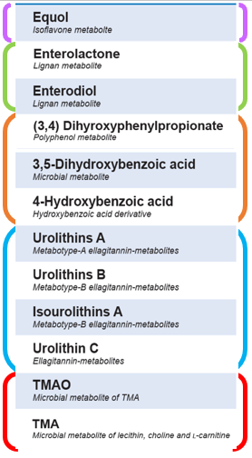
DIETARY MICROBIAL METABOLITES Choline and Carnitine Metabolites
Trimethylamine (TMA) is released by the action of gut bacteria, ~95% is converted to TMAO and excreted in urine.
Bacterial action of marine fish, eggs, offal, soya beans, peas, and red meat.
Strong positive correlation between urine and plasma.
Trimethylamine N-Oxide (TMAO) producer are more likely to be omnivores than vegetarians.
Checking levels when starting to supplement with carnitine is advised.
Citric acid, Hippurate, TMOA, and betaine were elevated in T2DM.
TMAO has been associated with increased risk of cardiovascular disease, reverse cholesterol transport, and glucose and lipid homeostasis.

Slide 50
3,5-dihydroxybenzoic acid
Ellagitannins
Metabolites
Lignan
Metabolites
Choline/Carnitine Metabolites
Phytoestrogen
Metabolites
(valerate, iso-valerate and iso-butyrate)
Phenolic
Metabolite
& Phenylalanine/Tyrosine Catabolites
(Indoleacetic acid)
(p-cresols, 3-Hydroxyphenylacetic acid,
p-Hydroxyphenylacetic acid
British Nutrition Foundation Nutrition
Bulletin, (2019) 44, 216–227
Notes:
The recommendation of a carbohydrate-rich diet after bariatric surgery in order to augment the saccharolytic- and reduce the proteolytic- fermentation seems to be reasonable clinical advice.
3,5-dihydroxybenzoic acid identifies wholgrains
Phenolic compounds more of a general marker of good saccharolytic intake

Slide 51
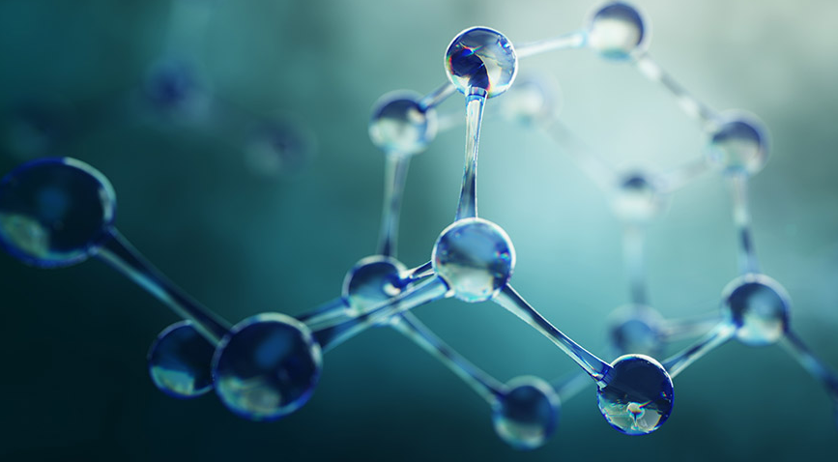
Chronic Kidney Disease (CKD)
In clinical practice, urea and creatinine levels have been traditionally used as markers of renal function for early identification of kidney disease. However, these tests have limitations and may under-estimate the disease stage. To overcome this exploration using “omics” sciences (such as metabolomics) has allowed the identification of new non-invasive biomarkers of renal function. – Peer J. 2019;7:e7113
Krebs Cycle Markers
Liver-type fatty acid-binding protein (L-FABP)

Slide 52
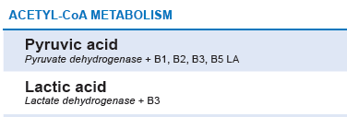

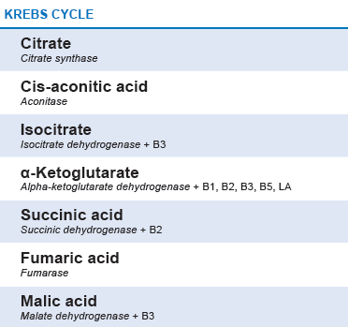
Chronic Kidney Disease (CKD)
Low
Low
Low
There is an emerging view of chronic kidney disease as a state of mitochondrial dysfunction.
High
High
INFLAMMATORY MARKER
Liver-type fatty acid-binding protein
(L-FABP)
Notes:
I would look at these first, but because no one usually JUST has kidney disease I would also look at other pathways

Slide 53
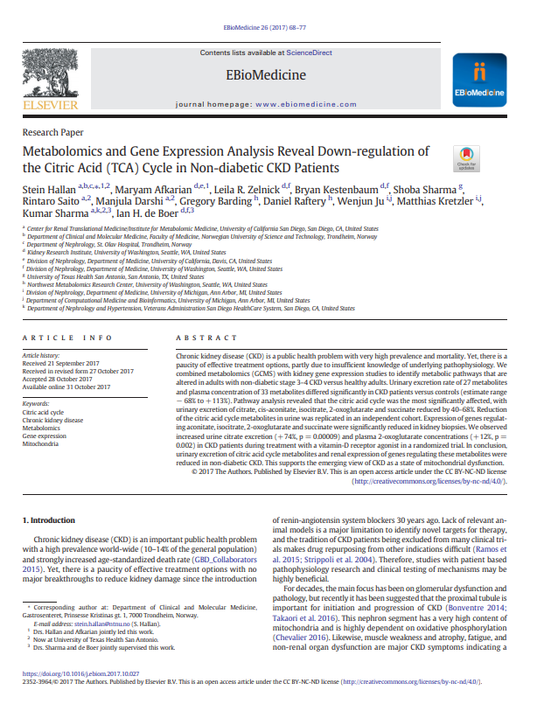
Down-regulation of Citric Acid Cycle in Non-diabetic CKD Patients
Researchers combined metabolomics with kidney gene expression studies to identify metabolic pathways that are altered in non-diabetic stage 3–4 chronic kidney disease versus healthy adults.
Urinary excretion differed significantly in patients versus controls.
The citric acid cycle was the most significantly affected, with citrate, cis-aconitate, isocitrate, 2-oxoglutarate and succinate reduced by 40–68% in patients.
S. Hallan et al. / EBioMedicine 26 (2017) 68–77
Notes:
Chronic kidney disease has very high prevalence and mortality. Yet, there is insufficient knowledge of underlying pathophysiology.
2. Kidneys have a high mitochondria content and oxygen
consumption to produce ATP for multiple energy consuming
functions, including biosynthesis, active waste
removal, filtrate reabsorption, and regulation of electrolyte
and acid-base balance. So a disruption of
mitochondrial homeostasis may reduce energy production
and lead to loss of renal function.
3. Slide
Reduction of the citric acid cycle metabolites in urine has been replicated in other independent cohorts.
---------------
Expression of genes regulating aconitate, isocitrate, 2-oxoglutarate and succinate were significantly reduced in kidney biopsies. Known risk factor for the development of kidney stones, kidney disease, chronic kidney disease.
fumarate accumulation may activate expression of TGF-b, the master regulator of
kidney fibrosis. A recent study in an animal model suggests that
fumarate may be a mediator linking kidney intracellular
oxidative stress and DKD pathogenesis

Slide 54
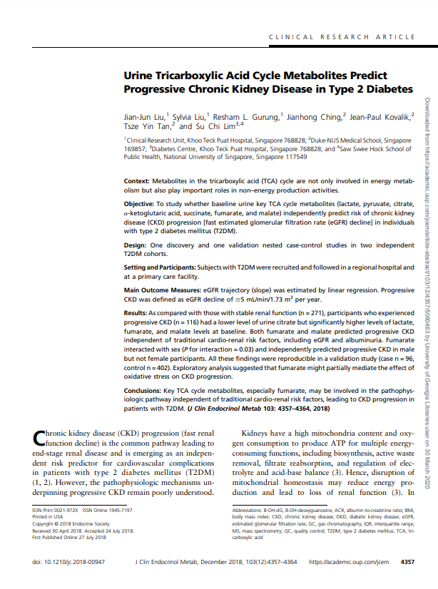
Urine Tricarboxylic Acid Cycle Metabolites Predict Progressive Chronic Kidney Disease in Type 2 Diabetes
Researchers evaluated whether baseline urine Krebs cycle metabolites independently predict risk of chronic kidney disease progression in individuals with type 2 diabetes mellitus.
As compared with those with stable renal function participants who experienced progressive chronic kidney disease had a lower level of urine citrate but significantly higher levels of lactate, fumarate, and malate levels at baseline.
J Clin Endocrinol Metab 103 (12), 4357-4364
Notes:
Read slide
Both fumarate and malate predicted progressive CKD
independent of traditional cardio-renal risk factors, including eGFR and albuminuria. A higher baseline fumarate
independently predicted progressive CKD in male but not female participants.

Slide 55
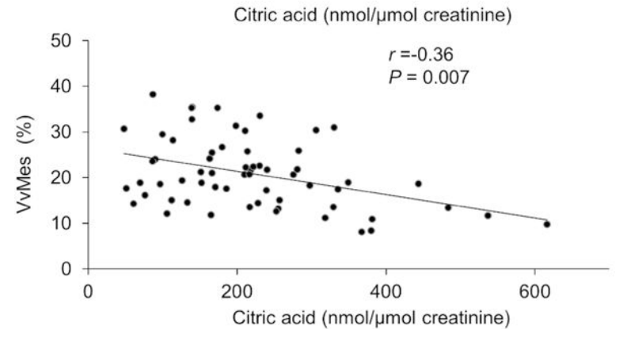
Citric Acid
In a 2018 review of urine metabolites and kidney health at baseline and 6 years later, alterations of urine metabolites were found to be associated with early glomerular lesions in diabetic kidney disease.
Citric acid correlated negatively with mesangial fractional volume (partial r=−0.36, P = 0.007), and homovanillic acid correlated negatively with podocyte foot process width (partial r=−0.31, P = 0.022).
Metabolomics. 2018;14(6):84.
Notes:
Metabolites were measured in urine samples collected within a median of 6.5 months before the research biopsy. Associations of the creatinine-adjusted urine metabolites with kidney structural variables were examined - At the end of the six-year clinical trial, 111 of the participants underwent percutaneous kidney biopsy to determine whether treatment was associated with preservation of kidney structure.

Slide 56


Urine Metabolites | T2DM | CKD w/o T2DM | CDK progression w/ T2DM vs controls | Animal Study
 |  |  |  | Mild KD | Mod KD | Sever KD
Lactic Acid | High |  | High | High
Krebs Cycle
Citric Acid | High | Low | Low | Low | Low | Low
Cis-Aconic acid |  | Low
Iso-citric acid |  | Low
Alpha-ketoglutaric acid |  | Low
Succinic Acid | High | Low |  | High | Low | Low
Fumaric acid | Low |  | High
Malic acid |  |  | High
High
J Clin Endocrinol Metab 103 (12), 4357-4364
Diabetes & metabolism. , 2018, Vol.44(3), p.261-268
S. Hallan et al. / EBioMedicine 26 (2017) 68–77
PeerJ. 2019;7:e7113
Notes:
Consider that he has CKD but not diabetes
CA in DM is generally found high, but its generally reported lower in CKD – may want to look at diabetes risk
Another marker is I would add is L-FABP

Slide 57


Liver-type Fatty Acid-Binding Protein: L-FABP or FABP1
L-FABP transports fatty acids into the mitochondria, and is a source of energy and protects against oxidative stress. Increased stress leads to increased L-FABP.
L-FABP is a promising biomarker for monitoring and early treatment of chronic kidney disease, and has been used for diagnosis of liver damage in hepatitis and cirrhosis.
Both VȮ 2 peak and grip strength were inversely associated with urinary L-FABP levels in middle-aged and older individuals without CKD.
urine
Mitochondria
urine
L-FABP
Notes:
First bullet
FABP, reflects the degree of tubulointerstitial disorder in kidneys, and is a new biomarker for prognostic estimation, monitoring, and early treatment of chronic kidney disease (CKD). L-FABP doesn’t reflect the consequences of failure of renal dysfunction, but is leaked into urine due to ischemia and oxidative stress.
(diagram) Albumin brings in the Free Fatty acids, L-FABP binds with them and takes it to the micochondria or lysosome. Reactive oxygen, generated from petibular ischemia/reperfussion injury change free fatty acids to peroxides (lipo-peroxides) – which are very toxic to cells. L-FABP binds them and takes them out in the urine.
Read – FABP has also has been used for diagnosis of liver damage in hepatitis and cirrhosis.
Researchers found a decline in exercise capacity was associated with a reduction in peritubular capillary blood flow, maybe giving insight into the underlying mechanism linking the decline in exercise capacity to the development of renal dysfunction.
https://www.sekisuimedical.jp/

Slide 58

Liver-type Fatty Acid-Binding Protein (L-FABP) and Chronic Kidney Disease (CKD) progression
L-FABP excretion adds prognostic information to the well-established risk markers, blood pressure, albumin excretion and baseline GFR, regarding progression of chronic kidney disease.
L-FABP was elevated in CKD patients when compared to controls at baseline.
The presented data supports L-FABP to be a relevant biomarker for prediction of decline (GFR) in renal function in CKD patients without albuminuria.
Scand J Clin Lab Invest. 2017 Nov;77(7):549-554.
Notes:
74 CKD patients against healthy controls for 18 months

Slide 59
Case Study: A 32-year-old Woman Referred due to Proteinuria and Chronic Constipation
An examination revealed the following:
height 156 cm & weight 54 kg
Normal renal function
serum creatinine 0.66 mg/dL
BUN 24.2 mg/dL
eGFR 85.4 mL/min/1.73 m²
proteinuria of 66.2 mg/dL
tubular dysfunction: (L-FABP) of 22.6 μg/g (normal range <7.4 μg/g)
positive urine occult blood (+++)
LDL-110 mg/dL, TG 66 mg/dL, HDL 76 mg/dL, total protein 7.1 g/dL, albumin 4.2 g/dL
Treatment: Lubiprostone, facilitates spontaneous bowel movement.
The patient's urinary protein excretion and L-FABP showed a gradual decline for 12 months.
Gut microbiota play a role in development of kidney diseases, and the “gut-kidney axis”
Gastrointestinal mucosal immune responses and altered gut microbiota may also be associated with the pathogenesis of IgA nephropathy.
Intern Med. 2019 Nov 15; 58(22): 3255–3259.
Notes:
There are an increasing number of studies suggesting that the Gut microbiota plays a pathophysiological role in the development of kidney diseases, and we shouldn’t overlook the “gut-kidney axis”
gastrointestinal mucosal immune responses and altered gut microbiota may also be associated with the pathogenesis of IgA nephropathy.
Thus, improving gut microbiota is expected to be a potential therapeutic approach in patients with IgA nephropathy.
~10% of the molecular features of urine have been found to be associated with colonic transit time

Slide 60
The Emerging Role of Applied Metabolomics
Incorporating Metabolomics In Practice
Presented by Betsy Redmond, PhD, MMSc, RDN

Slide 61
(Does not address degree of change, only direction) | Xanthurenic acid | Kynurenic acid | Anthranilic acid | Quinolinic acid
Vitamin B6 Deficiency | ↑
Oral Contraceptive Users | ↑ | ↑ | ↑
Vitamin B6 Deficiency with Tryptophan Load | ↑ | ↑ |  | ↑
Mathematical modeling a 5% B6 Deficiency (compared to adequate) | ↑ | ↓ | ↓ | ↑
Mathematical Modeling – Tryptophan Load Without B6 Deficiency | ↑ | ↑ | ↑ | ↑
Mathematical Modeling – Tryptophan Load with B6 Deficiency | ↑ | ↑ | ↑ | ↑
Notes:
The pattern you may see depends on several factors

Slide 62

Beyond Enzyme Cofactors
Krebs Cycle Markers
Citric Acid
Iso-citric Acid
Cis-aconitic Acid
Succinic Acid
Malic Acid
Fumaric Acid
Boumphreyfr / CC BY-SA (https://creativecommons.org/licenses/by-sa/3.0)
Notes:
While cofactors are important its also important to know the what the literature says about individual markers.
Citrate doesn’t need an enzyme cofactor but it is associated with a lot of conditions.
Higher Citric Acid Levels
Associated with Type 2 Diabetes.
Increased citric acid may indicated low arginine availability (animal studies).
Alkaline mineral or coconut water, supplements, may increase urinary citric acid.
Low Citric Acid Levels
Low bone mineral density was associated with hypocitraturia.
Lower citrate seen in immune-mediated inflammatory diseases, arthritis, psoriasis, psoriatic arthritis, lupus, Crohn’s disease, ulcerative colitis, as well as metabolic acidosis,

Slide 63

Investigated the use of prognostic markers for screening potential responders to maximize the benefits of nutritional intervention against oxidative stress.
Associations between the changes in traditional biochemical markers and urinary metabolomic signatures at baseline.
A higher level of a two-metabolite set at baseline predicted responders to dietary interventions in subjects with oxidative stress and inflammation.
Notes:
They looked at the associations between the changes in traditional biochemical markers and urinary metabolomic signatures at baseline- Asking what baseline biochemical characteristics would identify those people who would most likely respond positivitely to the antioxidant supplementation.
Their findings suggest that a higher level of this two-metabolite set at baseline is useful for predicting responders to dietary interventions in subjects with oxidative stress and inflammation, contributing to the emergence of personalized nutrition.
“it looks like you could be a good candidate for antioxidant treatment. Lets start with that.”

Slide 64

Investigated the use of prognostic markers for screening potential responders to maximize the benefits of nutritional intervention against oxidative stress.
Associations between the changes in traditional biochemical markers and urinary metabolomic signatures at baseline.
Notes:
Their findings suggest that a higher level of this two-metabolite set at baseline is useful for predicting responders to dietary interventions in subjects with oxidative stress and inflammation, contributing to the emergence of personalized nutrition.
“it looks like you could be a good candidate for antioxidant treatment. Lets start with that.”

